Slide 1
ImageNet Classification with Deep Convolutional
Neural Networks, 2012
BHAVNA NAGAR
PARAG DUDEJA

Slide 2
Authors
Alex Krizhevsky
University of Toronto
kriz@cs.utoronto.ca
Ilya Sutskever
University of Toronto
ilya@cs.utoronto.ca
Geoffrey E. Hinton
University of Toronto
hinton@cs.utoronto.ca

Slide 3
Outline
Importance of AlexNet
Paper Abstract
Introduction
Dataset
Architecture
Reduce Overfitting
Training
Results
Code

Slide 4
AlexNet - The most influential paper on data science
AlexNet is considered one of the most influential papers published in computer vision, having spurred many more papers published employing CNNs and GPUs to accelerate deep learning.
As of late 2022, the AlexNet paper has been cited over 100,000 times according to Google Scholar
Taught to all aspiring data scientists, at universities and online
Fastest growing academic requirement for new positions
Applications are rather narrow: image to tags
Recognising faces for photos in social context
Flagging content for further attention, search
Ideas could be applied to other computationally intensive tasks
Solutions are too complex to be explained to a human

Slide 5
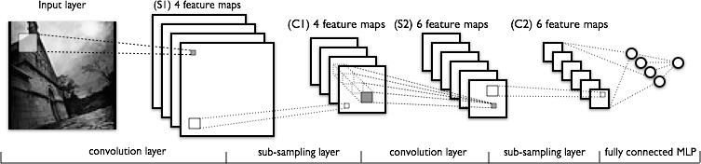
Convolutional Neural Networks (CNN)

Slide 6
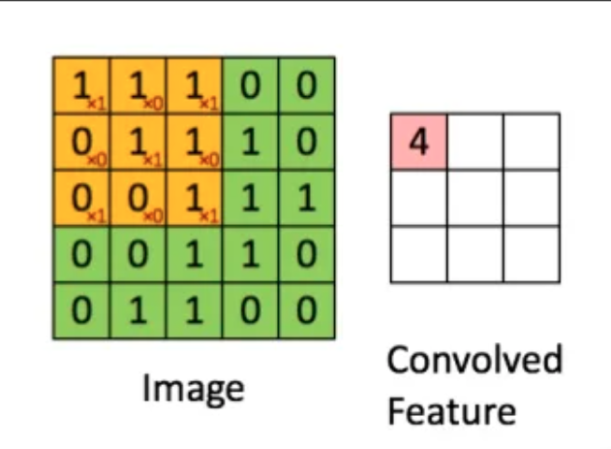
Matrix filter aka Convolutions
Local concerns
Hierarchical structure
Each cell of filter is parameter
One layer typically share a set of filters
Kernel = Filter = Weight = Feature Matrix = Feature map = Activation map = Parameters to be trained

Slide 7
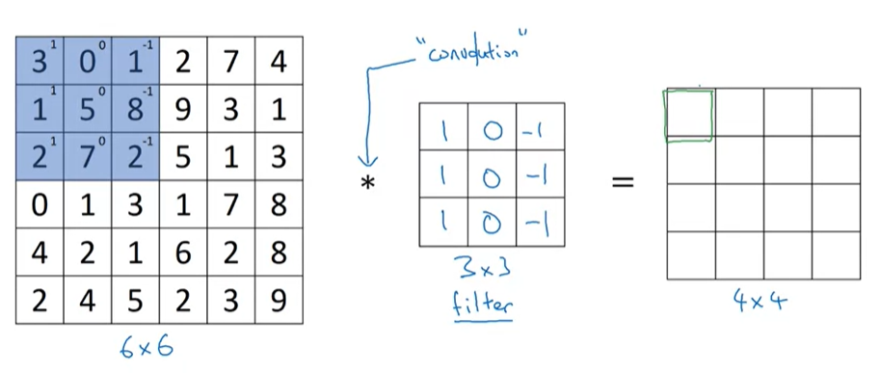
Matrix filter aka Convolutions
3*1+0*0+1*(-1)+1*1+5*0+8*(-1)+2*1+7*0+2*(-1)=-5

Slide 8
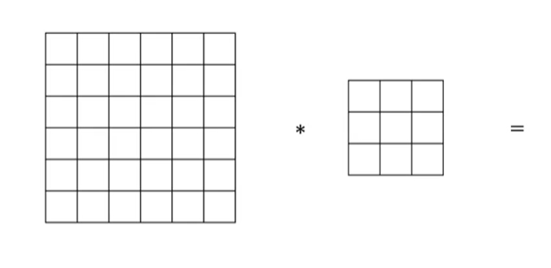
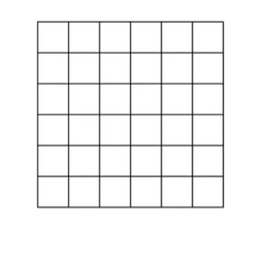
Convolutions with Padding
3X3
6X6
6X6
How much padding is required ? ( f-1)/2=1

Slide 9
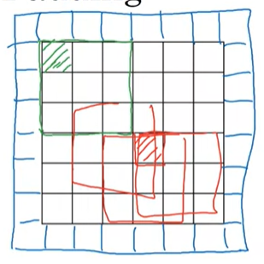
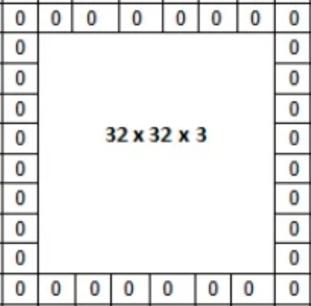
Padding
6X6

Slide 10
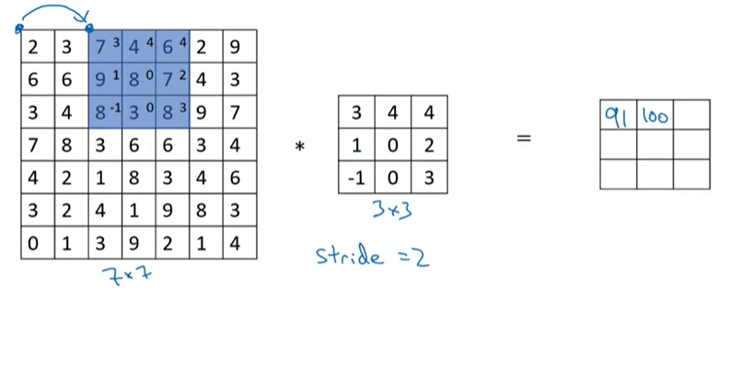
Striding

Slide 11
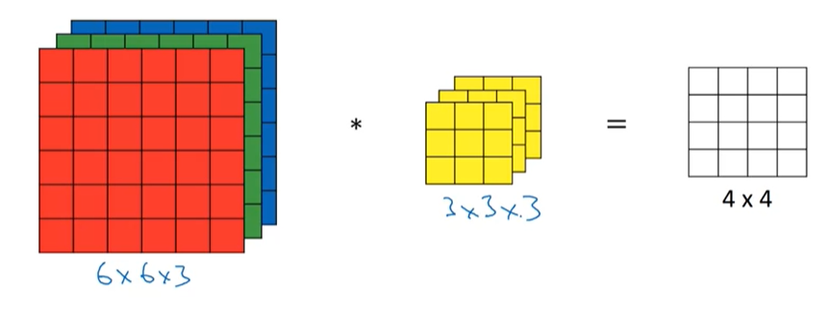
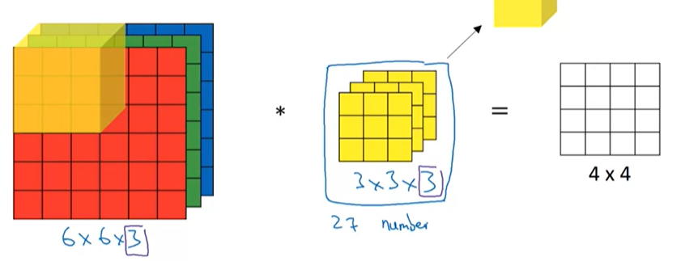
Convolution over volume

Slide 12
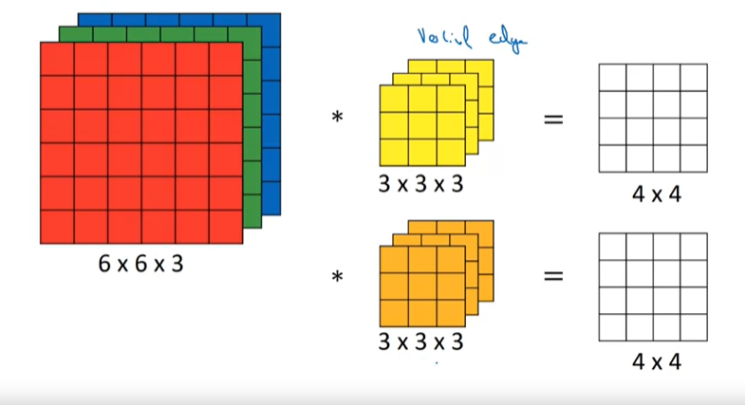
Convolution with more than one filter
Final output dimension=4X4X2

Slide 13
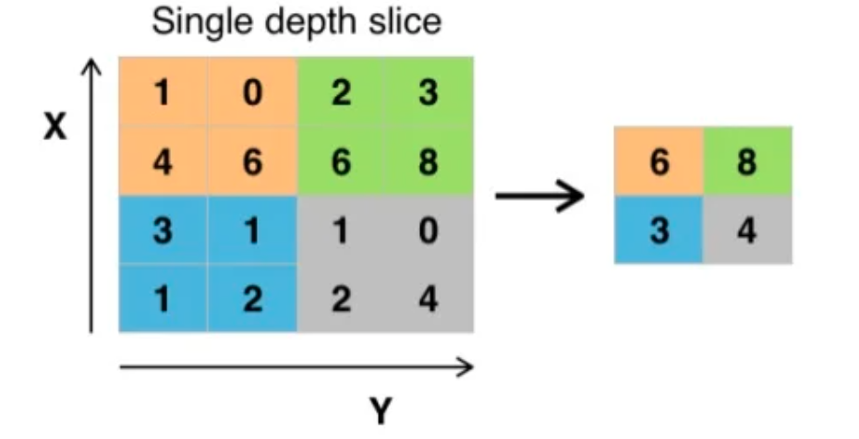
Pooling, typically using MaxPool
Stride
N^{[1]} x N^{[1]} -> N^{[2]} x N[^{2]} = N^{[1]}/stride x N^{[1]}/ stride

Slide 14
Abstract
“We trained a large, deep convolutional neural network to classify the 1.2 million high-resolution images in the ImageNet LSVRC-2010 contest into the 1000 different classes. On the test data, we achieved top-1 and top-5 error rates of 37.5% and 17.0% which is considerably better than the previous state-of-the-art. The neural network, which has 60 million parameters and 650,000 neurons, consists of five convolutional layers, some of which are followed by max-pooling layers, and three fully-connected layers with a final 1000-way softmax. To make training faster, we used non-saturating neurons and a very efficient GPU implementation of the convolution operation. To reduce overfitting in the fully-connected layers we employed a recently-developed regularization method called “dropout” that proved to be very effective. We also entered a variant of this model in the ILSVRC-2012 competition and achieved a winning top-5 test error rate of 15.3%, compared to 26.2% achieved by the second-best entry.”

Slide 15
Introduction
Convolutional Neural Network (CNN)
Winner of ImageNet Large Scale Visual Recognition Challenge (ILSVRC) 2012
first successful CNN application for such a big dataset
top-5 test error rate of 15.3% (+10.9% compared to 2nd)
Relatively simple layout (compared to modern architectures)
5 conv. layers
3 fully connected layers
max-pooling layers
dropout layers

Slide 16
Dataset
ImageNet Large-Scale Visual Recognition Challenge (ILSVRC)
15 million high-resolution images
22k hierarchical labels via Amazon's Mech. Turk
1.2 M training, 50k validation & 150k testing images
Test on subset of 1000 images in 1000 categories
Down-sampled images to 256 x 256
Rectangular images: rescaled shorter side to 256 & cropped
middle
Subtracting the mean activity over the training set from each
pixel
No other pre-processing

Slide 17
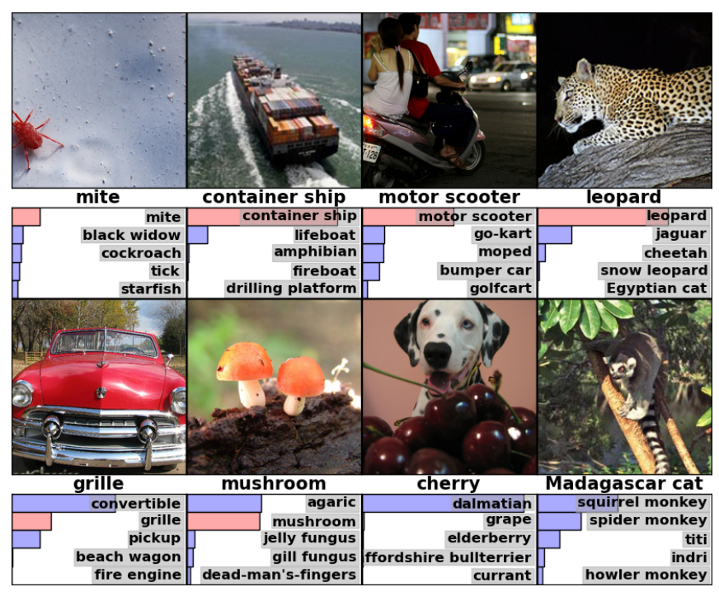
Task

Slide 18
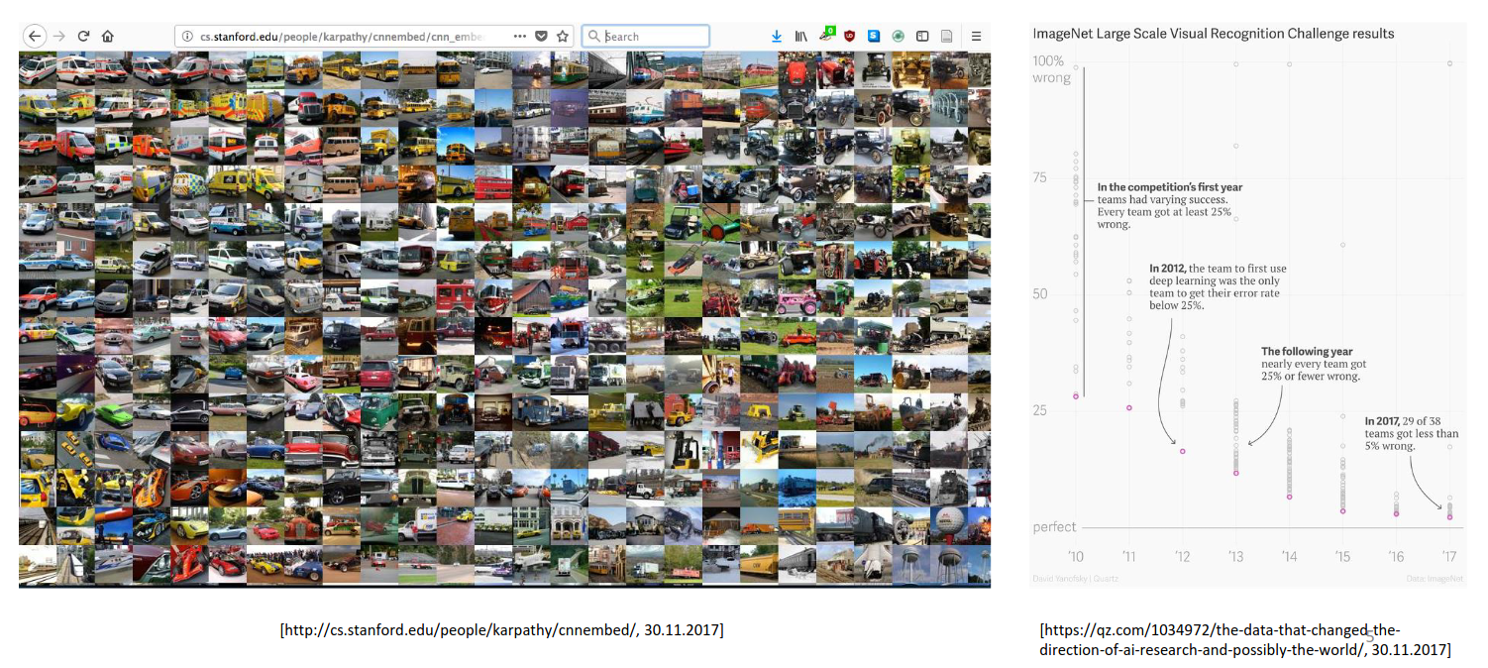
Dataset

Slide 19
Architecture: General Features
650K neuron
60M Parameters
630M connections
7 hidden weight layers
Rectified Linear Units (Relu)
Dropout trick
Randomly extracted patches with the size of (224*224)

Slide 20
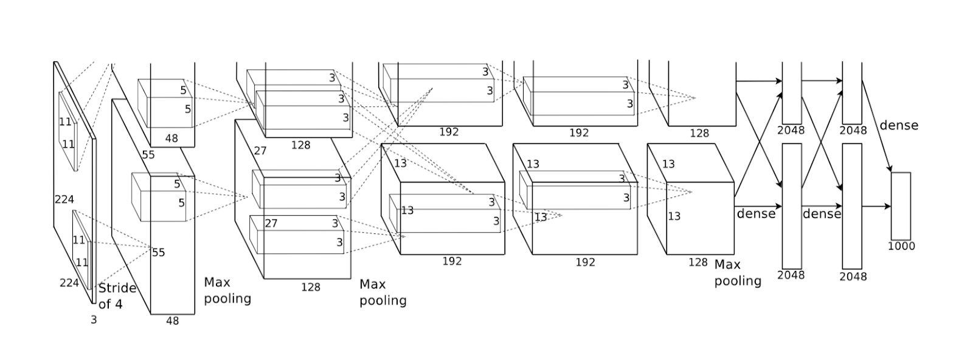
Architecture

Slide 21
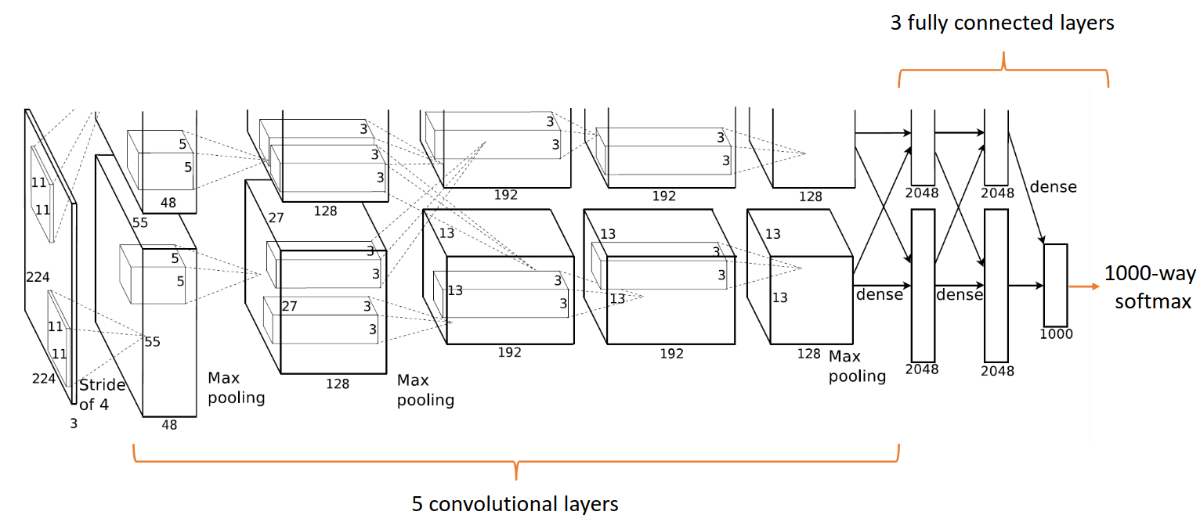

Slide 22
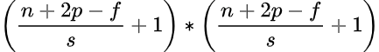
Why 224x224 does not work?
–> For n = 224, p = 0, f = 11, s=2 => 54.25 * 54.25
Wrong! Expected 55
-> For n = 227, p = 0, f = 11, s=2 => 55 * 55
Correct, as expected

Slide 23
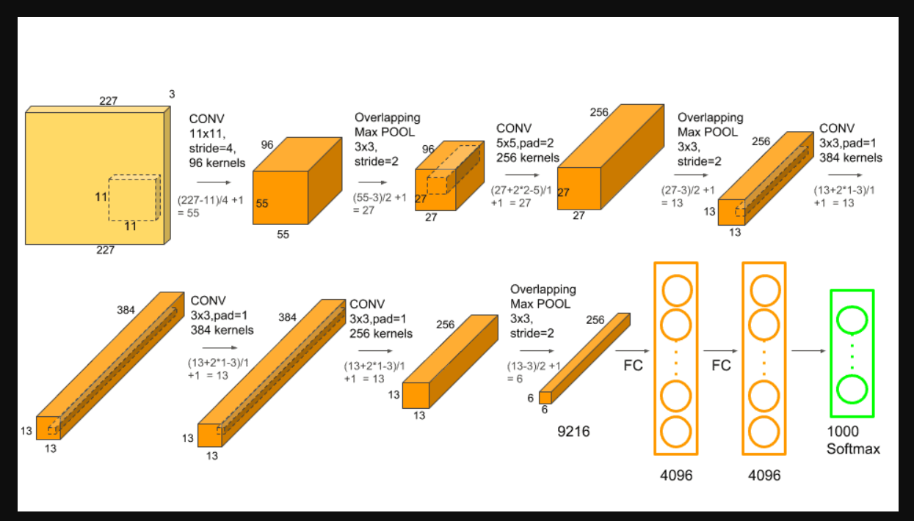

Slide 24
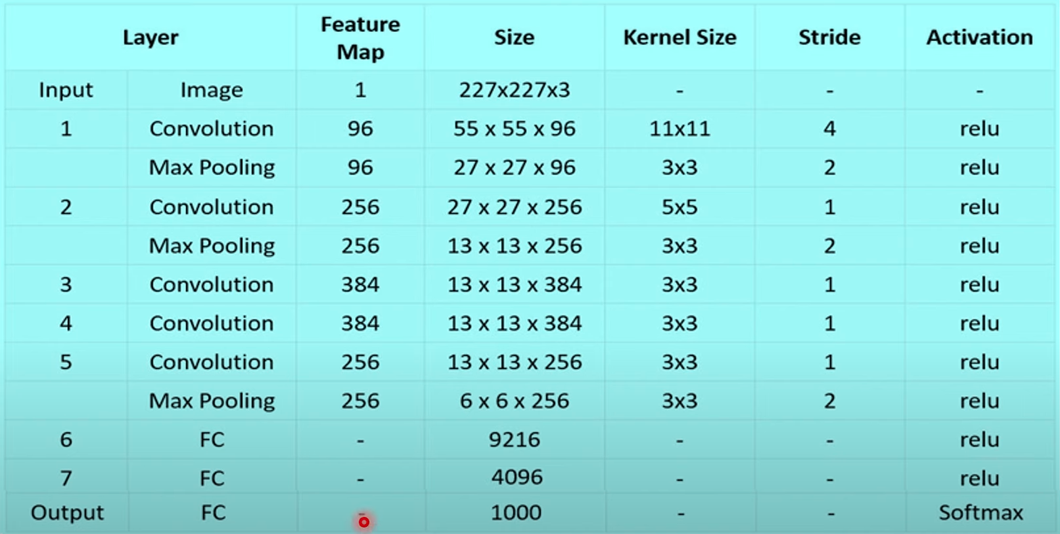
Dimensions

Slide 25
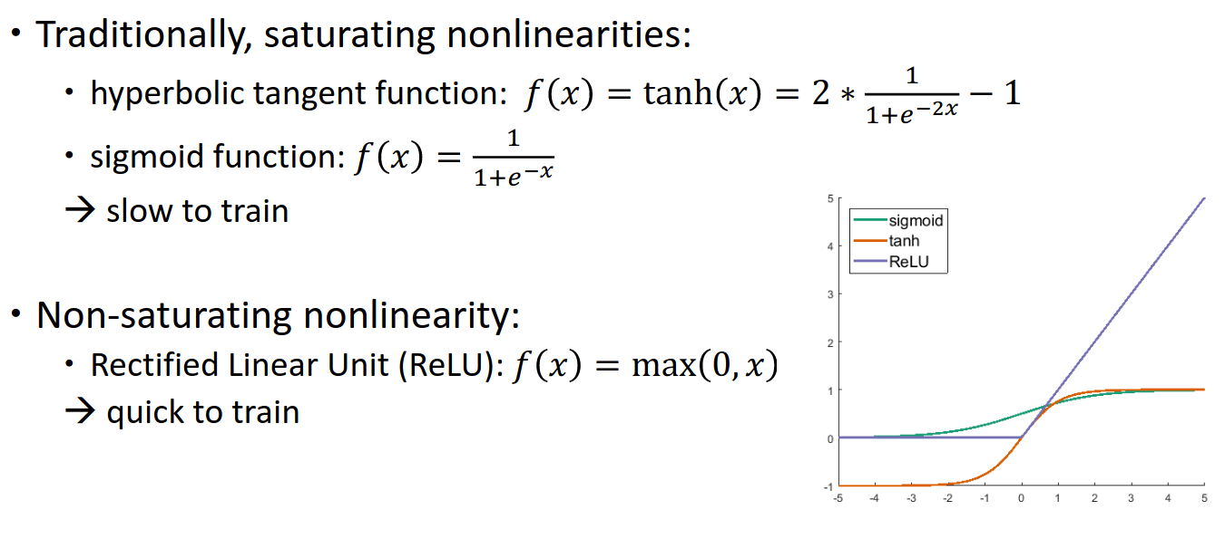
Novel/Unusual features: Activation functions

Slide 26
Novel/Unusual features (continued…)
Multiple GPUs
Larger memory
Parallel computing
Control of communication

Slide 27
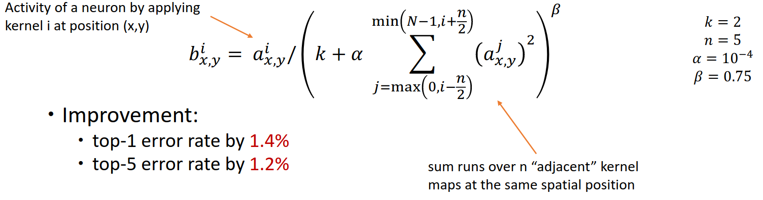
Local Response Normalization
ReLUs do not require input normalization to prevent them from saturating
However, Local Response Normalization aids generalization

Slide 28
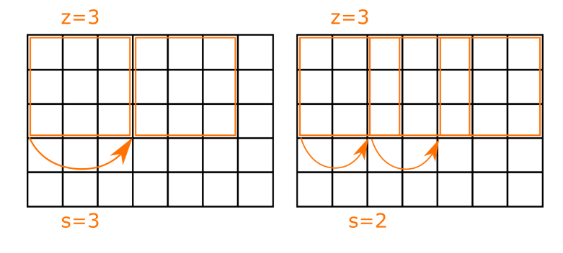
Overlapping Pooling
Pooling layers summarize the outputs of neighboring neurons in the same kernel map.
Overlapping pooling -> s < z
Improvement using MaxPooling
top-1 error rate by 0.4%
top-5 error rates by 0.3%

Slide 29
Reducing Overfitting: Data Augmentation
Artificially enlarge dataset
Image translation and horizontal reflection
Randomly extracting patches
Four corner and one center patches with reflection for testing
Altering the intensities of the RGB channels in training images
Approximately captures an important property of natural images reduces the top-1 error rate by over 1%

Slide 30
Reducing Overfitting: Dropout
Zero the output of each hidden neuron with probability 0.5.
No longer contribute to forward pass and backward propagation
Neural network samples a different architecture every time
Reduce complex co-adaptations of neurons
Used in two fully-connected layers

Slide 31
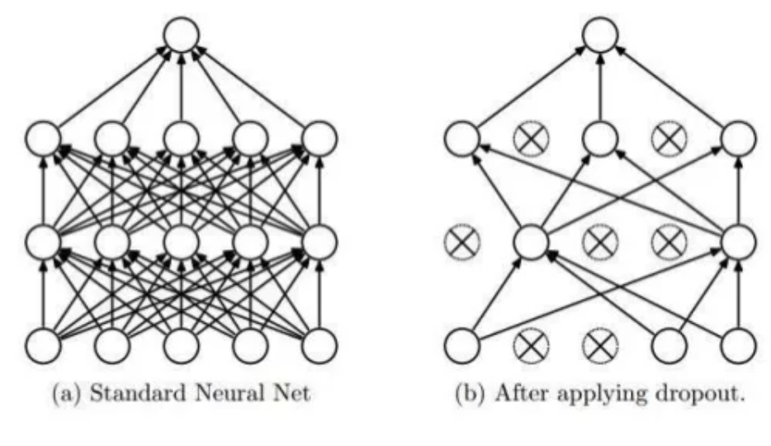

Slide 32
Training
Stochastic gradient descent
Batch size of 128 examples
Large momentum of 0.9
Small decay of 0.0005

Slide 33
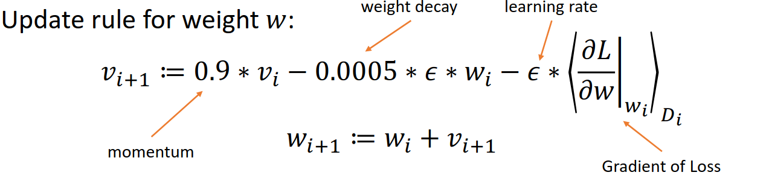
Training (continued…)
Initialisation: not null to give signal to ReLU
w₀ ~ N(0, 0.01)
a₀ = 1 in 2nd, 4th & 5th convolutional & fully-connected hidden layers
Learning rate: 0.01 overall
Divided by 10 when validation error was not improving

Slide 34
Results
Two NVIDIA GTX 580 3GB GPUs
6 days of training
90 cycles
60 million parameters
37.5% top-1 error (45.7% second best)
17% top-5 error (28.2% second best)

Slide 35
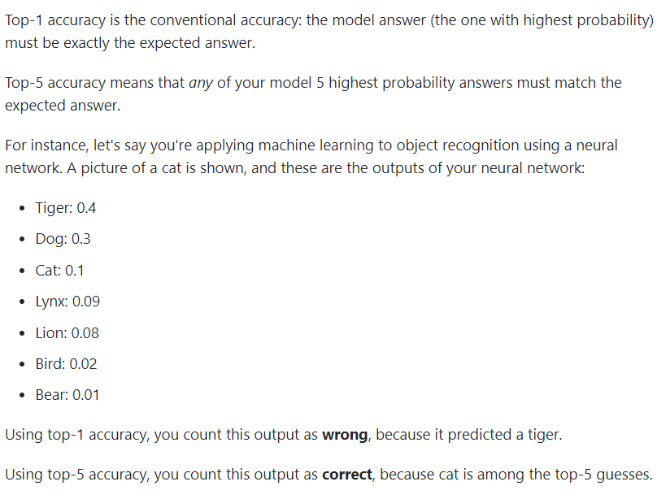

Slide 36
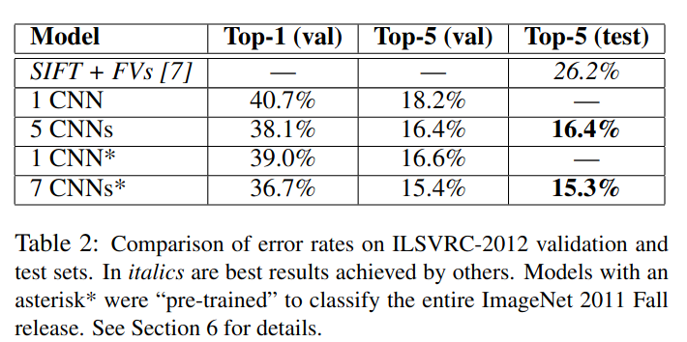
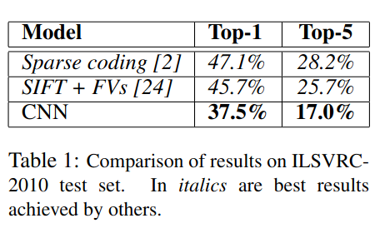

Slide 37
It’s time to Code

Slide 38
Any Questions?

